Slide 1
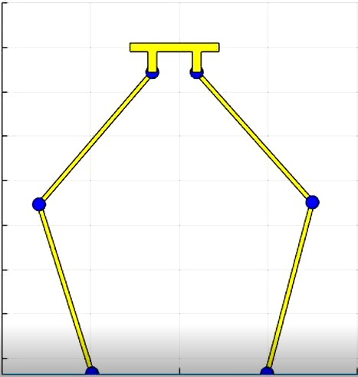
Locomotion in Non - Anthropomorphic Bipedal Robot Operating System ( NABIROS)
PRESENTED BY : SAURABH BELGAONKAR
SAJID AHAMED M A
ESHWAR S R

Slide 2
Contents
Why NABIROS ?
3D SolidWorks Model
ZMP Based Static walking trajectory generation
Dynamics of NABIROS
Reinforcement learning of NABI Locomotion
Future Work
Mania, Horia, Aurelia Guy, and Benjamin Recht. "Simple random search provides a competitive approach to reinforcement learning." arXiv preprint arXiv:1803.07055 (2018).
J. Yu, J. Hooks, S. Ghassemi, A. Pogue and D. Hong, "Investigation of a non-anthropomorphic bipedal robot with stability, agility, and simplicity," 2016 13th International Conference on Ubiquitous Robots and Ambient Intelligence (URAI)
S. Kajita et al., "Biped walking pattern generation by using preview control of zero-moment point," 2003 IEEE International Conference on Robotics and Automation
References

Slide 3
What are Bipeds?
Bipedalism – Locomotion by mean of two legs. Example - Humans
Main difficulty - Establishing a stable control as biped robots are more demanding regarding their dynamic balance.
They can operate seamlessly in locations made for people (houses, factories).
Consume less energy than other robots with more legs.
Motivation

Slide 4
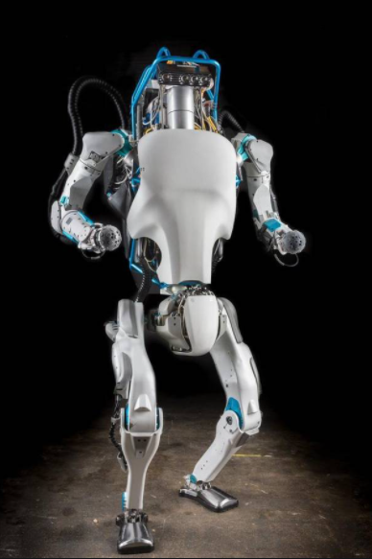
Limitations of Humanoid robots
Unstable
Slow
Expensive
Complex

Slide 5
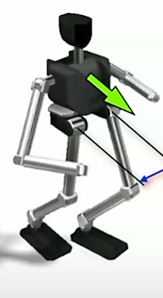
Reason for Instability of humanoid
One of the reasons why bipedal walking is difficult on humanoids is because of the offset in the hip joints in the frontal plane.
In typical forward walking, this offset creates undesirable oscillatory moments that force the robot to lean in the direction orthogonal to the direction of motion.
A small perturbation in this orthogonal direction can then easily destabilize the robot, and humanoid robots would struggle to recover from this sort of disturbance.
However, these moments don’t appear when taking steps side to side (as the hip offset is in line with the direction of motion), and if the main mode of transport is sideways walking, the leg can be simplified significantly.

Slide 6
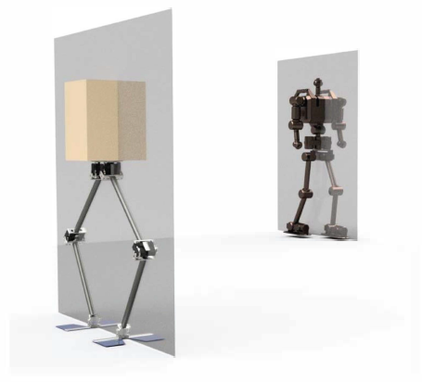
Non – Anthromorphic Biped ( NABI)
This Non-Anthropomorphic Bipedal Robotic System (NABiRoS/NABi-1) modifies the traditional bipedal form by aligning the legs in the sagittal plane.
Its leg design makes it difficult to tip over in the sagittal plane by keeping its center of mass within a constrained space.
Open Control loop.
4 actuated DOF.
Sagittal plane of NABiRoS (Left) is compared to a traditional anthropomorphic humanoid robot (Right).

Slide 7
Locomotion in Non Anthromorphic Robot
Control based approach
1
3
Dynamic simulator
Walking motion
Learning based approach
2

Slide 8
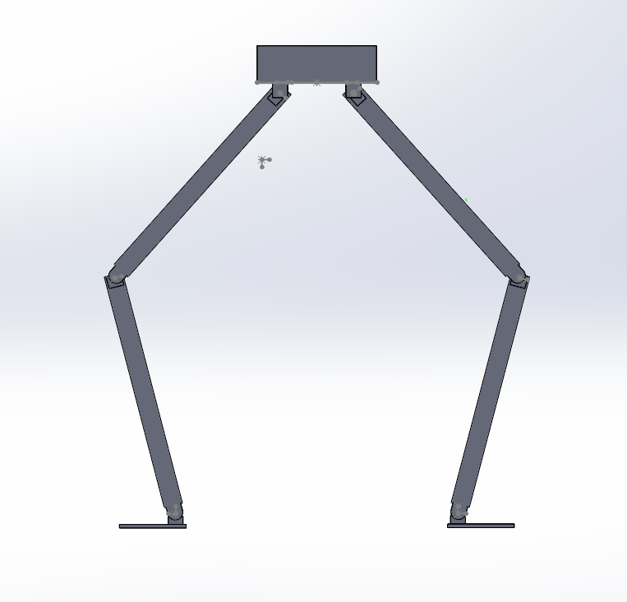
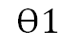
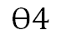
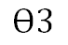
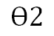
SolidWorks Model
$$Ɵ3$$
$$Ɵ1$$
605mm
$$Ɵ4$$
$$Ɵ2$$
381mm

Slide 9
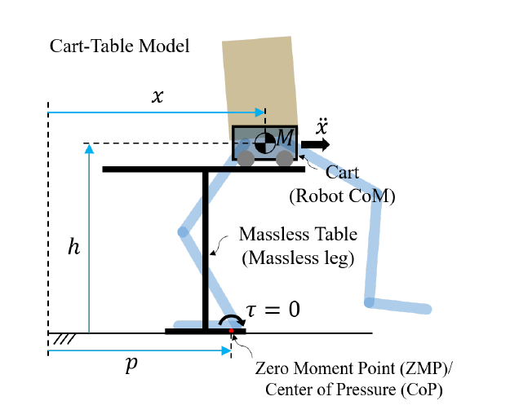
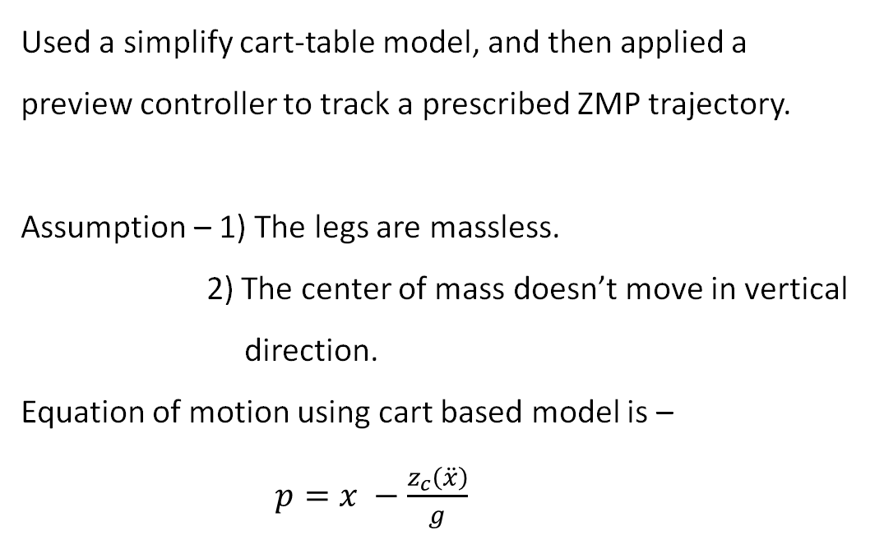
ZMP based approach
Used a simplify cart-table model, and then applied a preview controller to track a prescribed ZMP trajectory.
Assumption – 1) The legs are massless.
2) The center of mass doesn’t move in vertical
direction.
Equation of motion using cart based model is –
$p=x −\frac{z_{c}\left(\ddot{x}\right)}{g}$

Slide 10
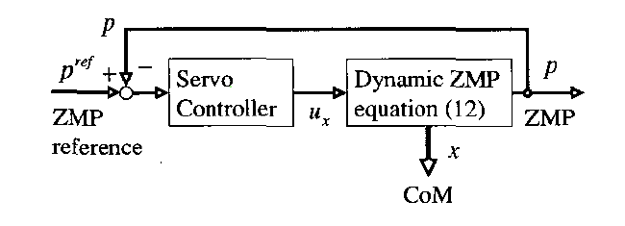
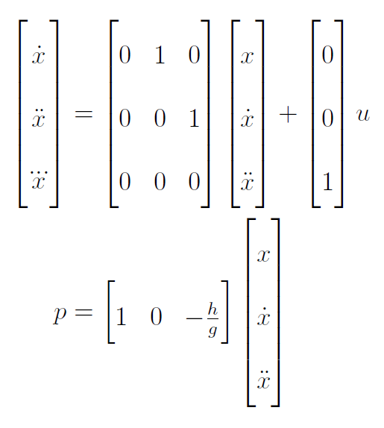
State Space representation
In the state space representation, the system is augmented so that the system input u is the jerk of the CoM.
Now, this model can be used with a preview controller that utilizes future information of the ZMP reference trajectory in order to yield a smooth CoM trajectory.

Slide 11
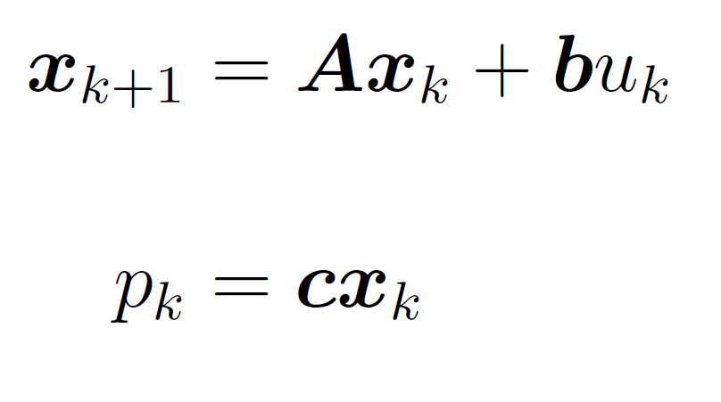
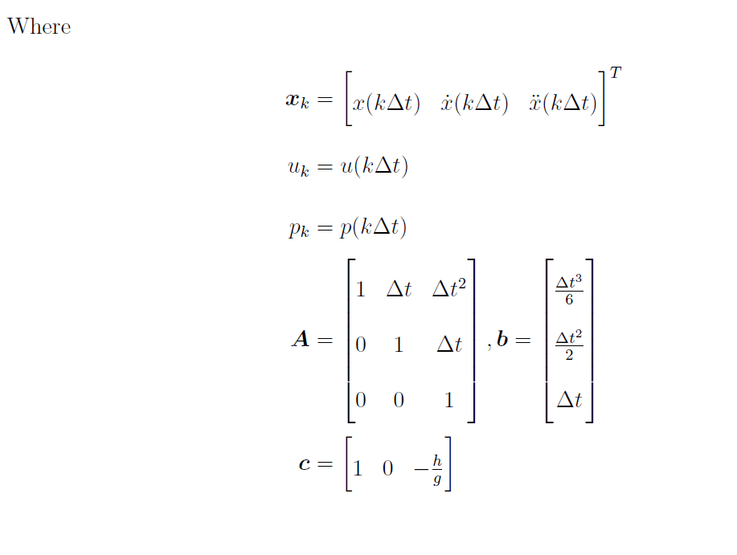
Discretization of the system

Slide 12
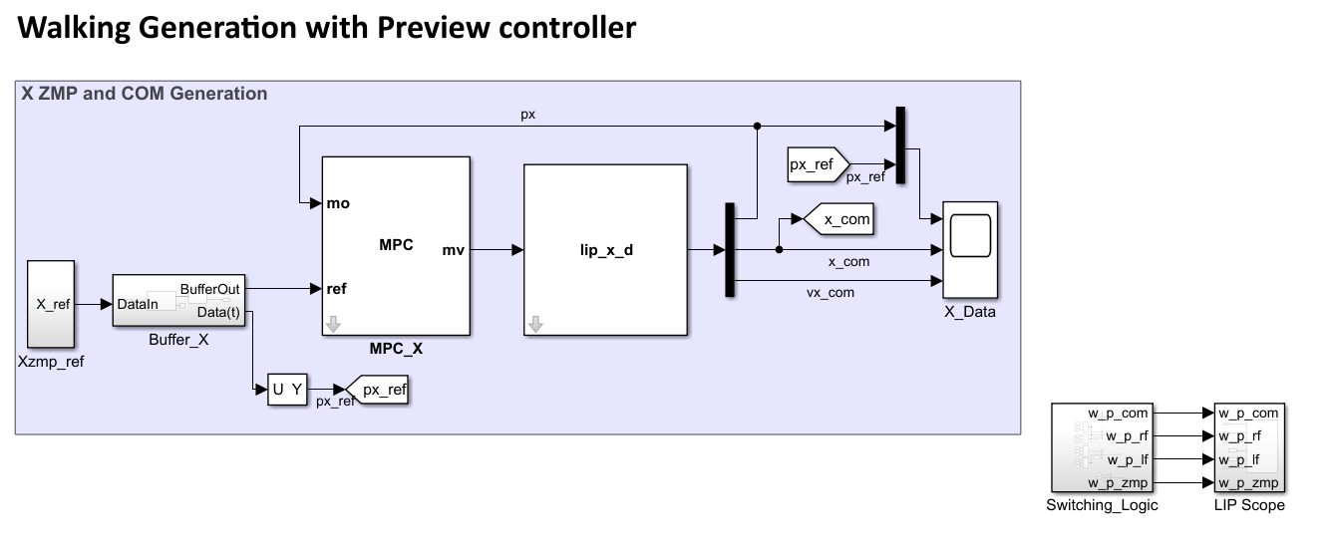
Preview Controller

Slide 13
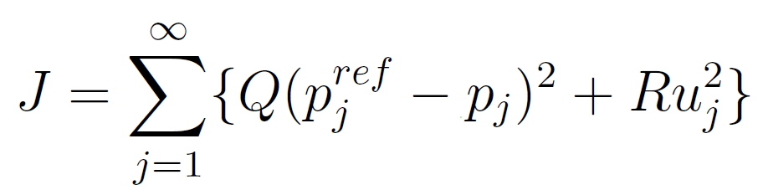
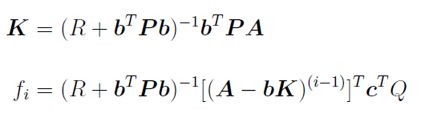
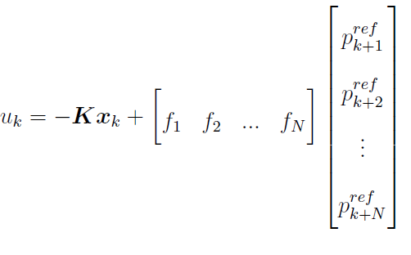
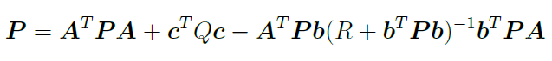
Preview Controller
Now, to track a reference trajectory, we minimize the following quadratic cost:
For a preview controller, cost J is minimized by the following input:
Where -
And P is the solution to the discrete Riccati Equation:

Slide 14
Steps
1) Prescribe foot placements which the robot will take i.e give step size.
2) Then a ZMP trajectory p(t) through the support polygon that is produced by the prescribed foot placements.
3) Utilize the ZMP preview controller described above to track the desired ZMP trajectory, outputting a CoM trajectory in the process.
4) With the location of the feet and CoM known for a specified number of steps (and time), the robot legs can be commanded to track the trajectory via inverse kinematics.
5) An additional motion is necessary to be implemented for the swing leg for taking steps. For NABiRoS, the swing foot is commanded to follow a cycloid function which can help reduce the impact when contacting the ground.

Slide 15
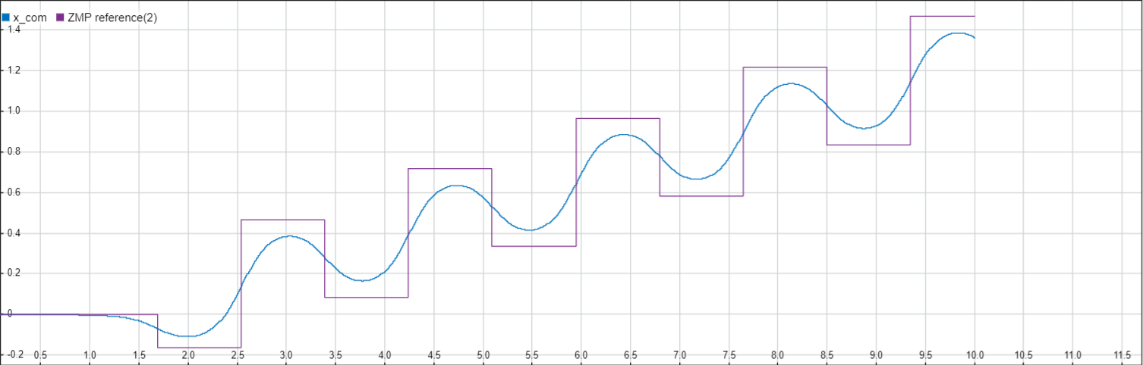
Parameters
Step length = 0.20 m Time period for step = 0.7 sec
Preview Period = 1.4 sec
ZMP ref vs Xcom plot

Slide 16
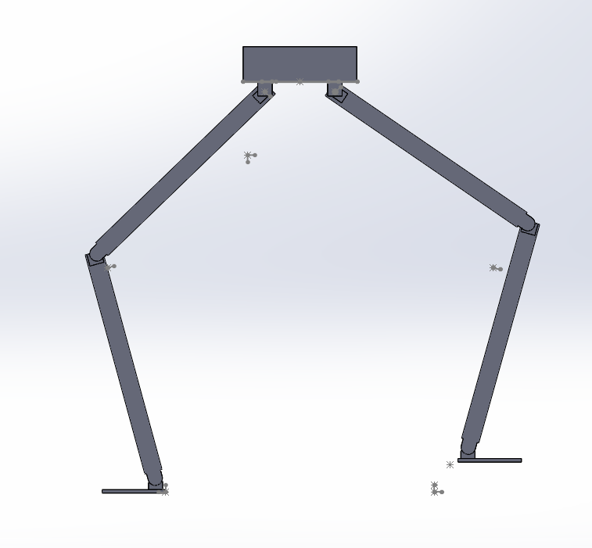
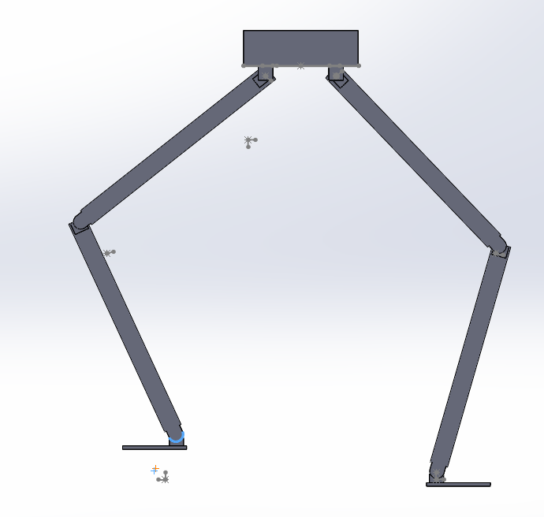
Inverse Kinematics
2 phase
1) Front leg is swinging
and Back leg is supporting.
2) Back leg is swinging, and Front leg is supporting.

Slide 17
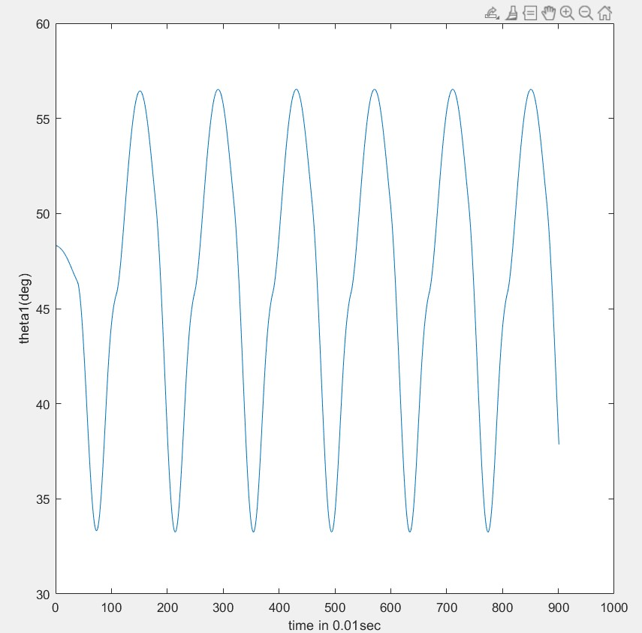
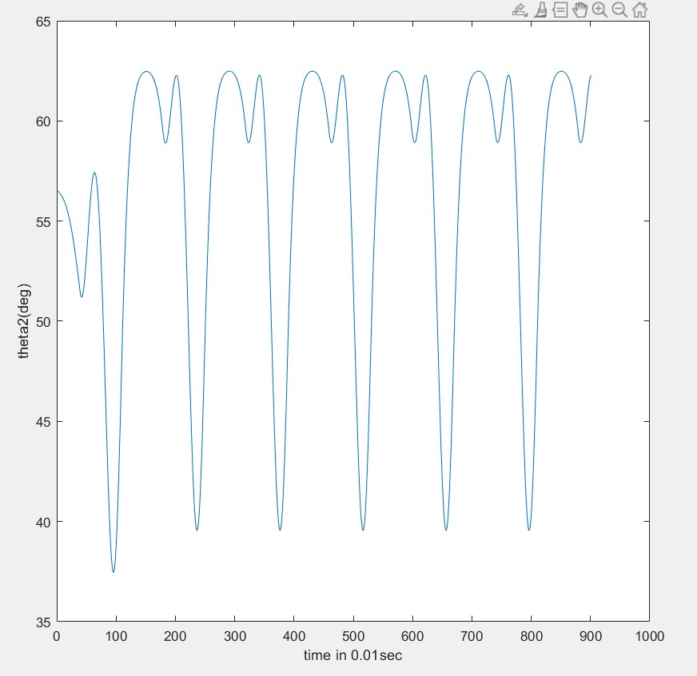
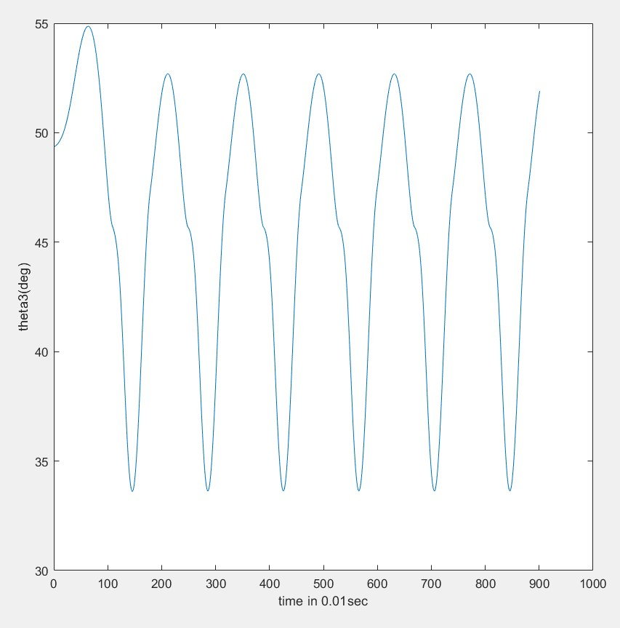
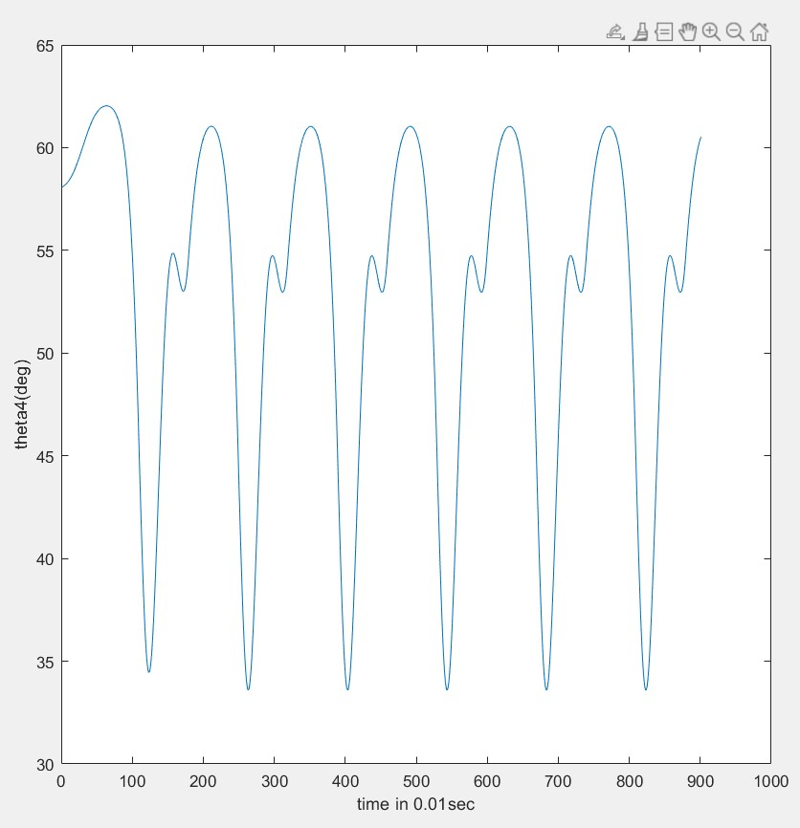
Plots for Desired Joint Angles

Slide 18
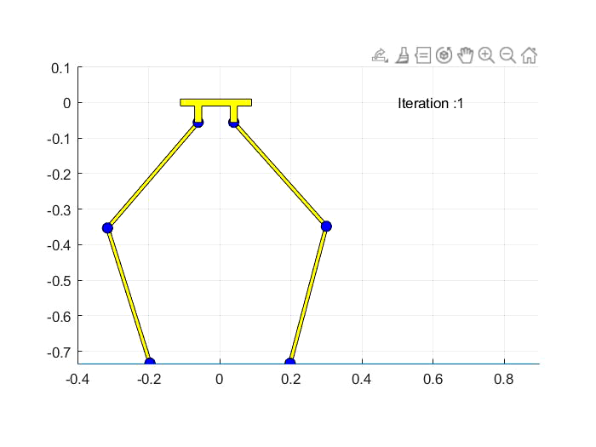
VIDEO
KINEMATIC WALKING BASED ON GENERATED ZMP COM TRAJECTORY

Slide 19

DYNAMICS OF NABIROS
Motivation :
For in-depth understanding of closed chain and parallel manipulator mechanics.
Limit the real-world disturbances to sagittal plane so that nonlinear effects due to $Iω x ω$ terms are not introduced.
Comparison of approximate model dynamics (Spring Load Inverted Pendulum) with the actual response for validating controller designed.

Slide 20
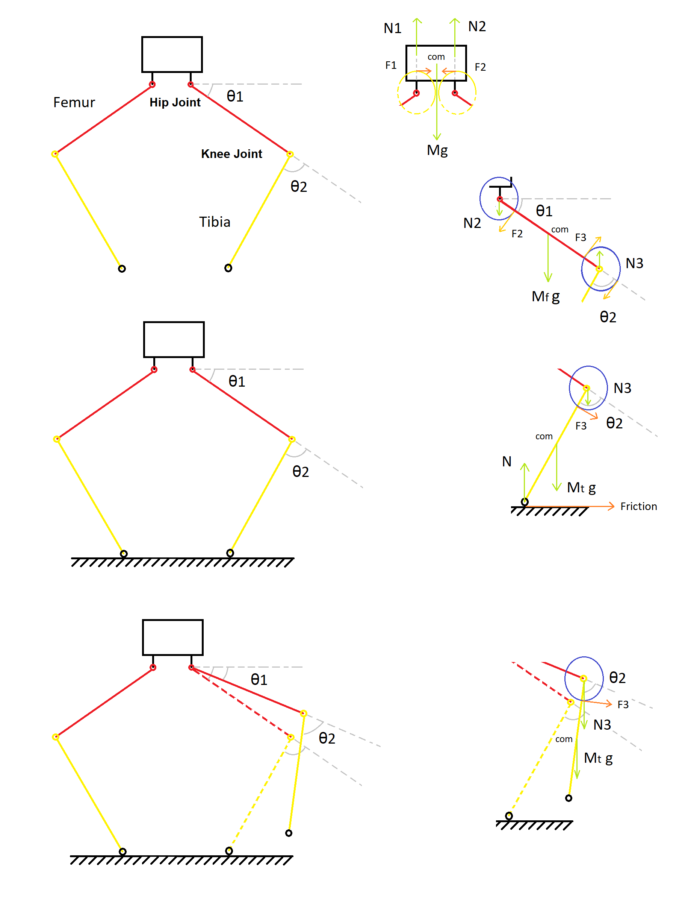
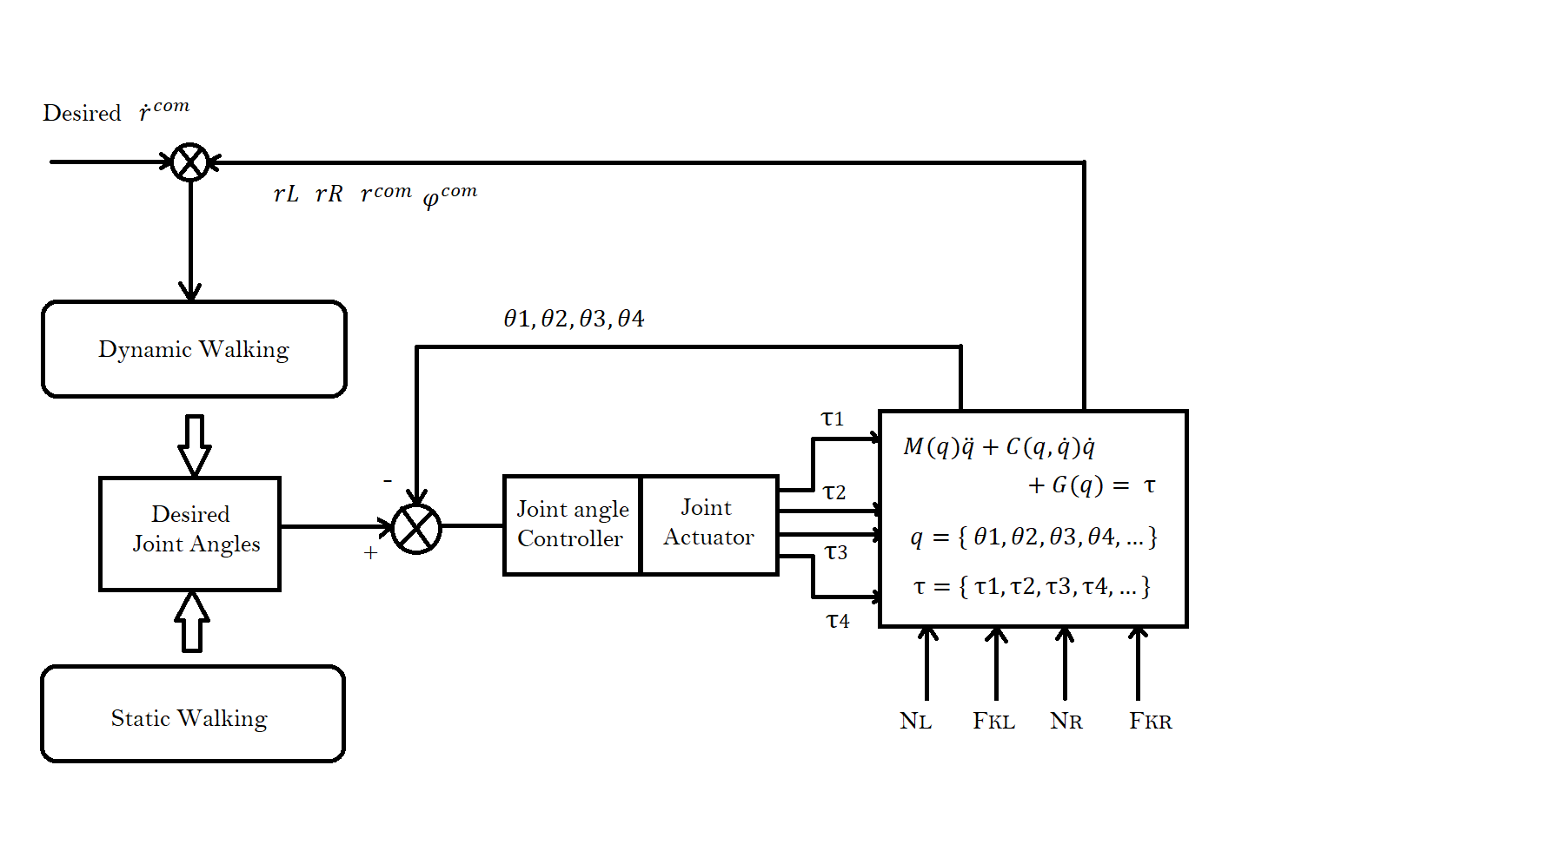

Slide 21
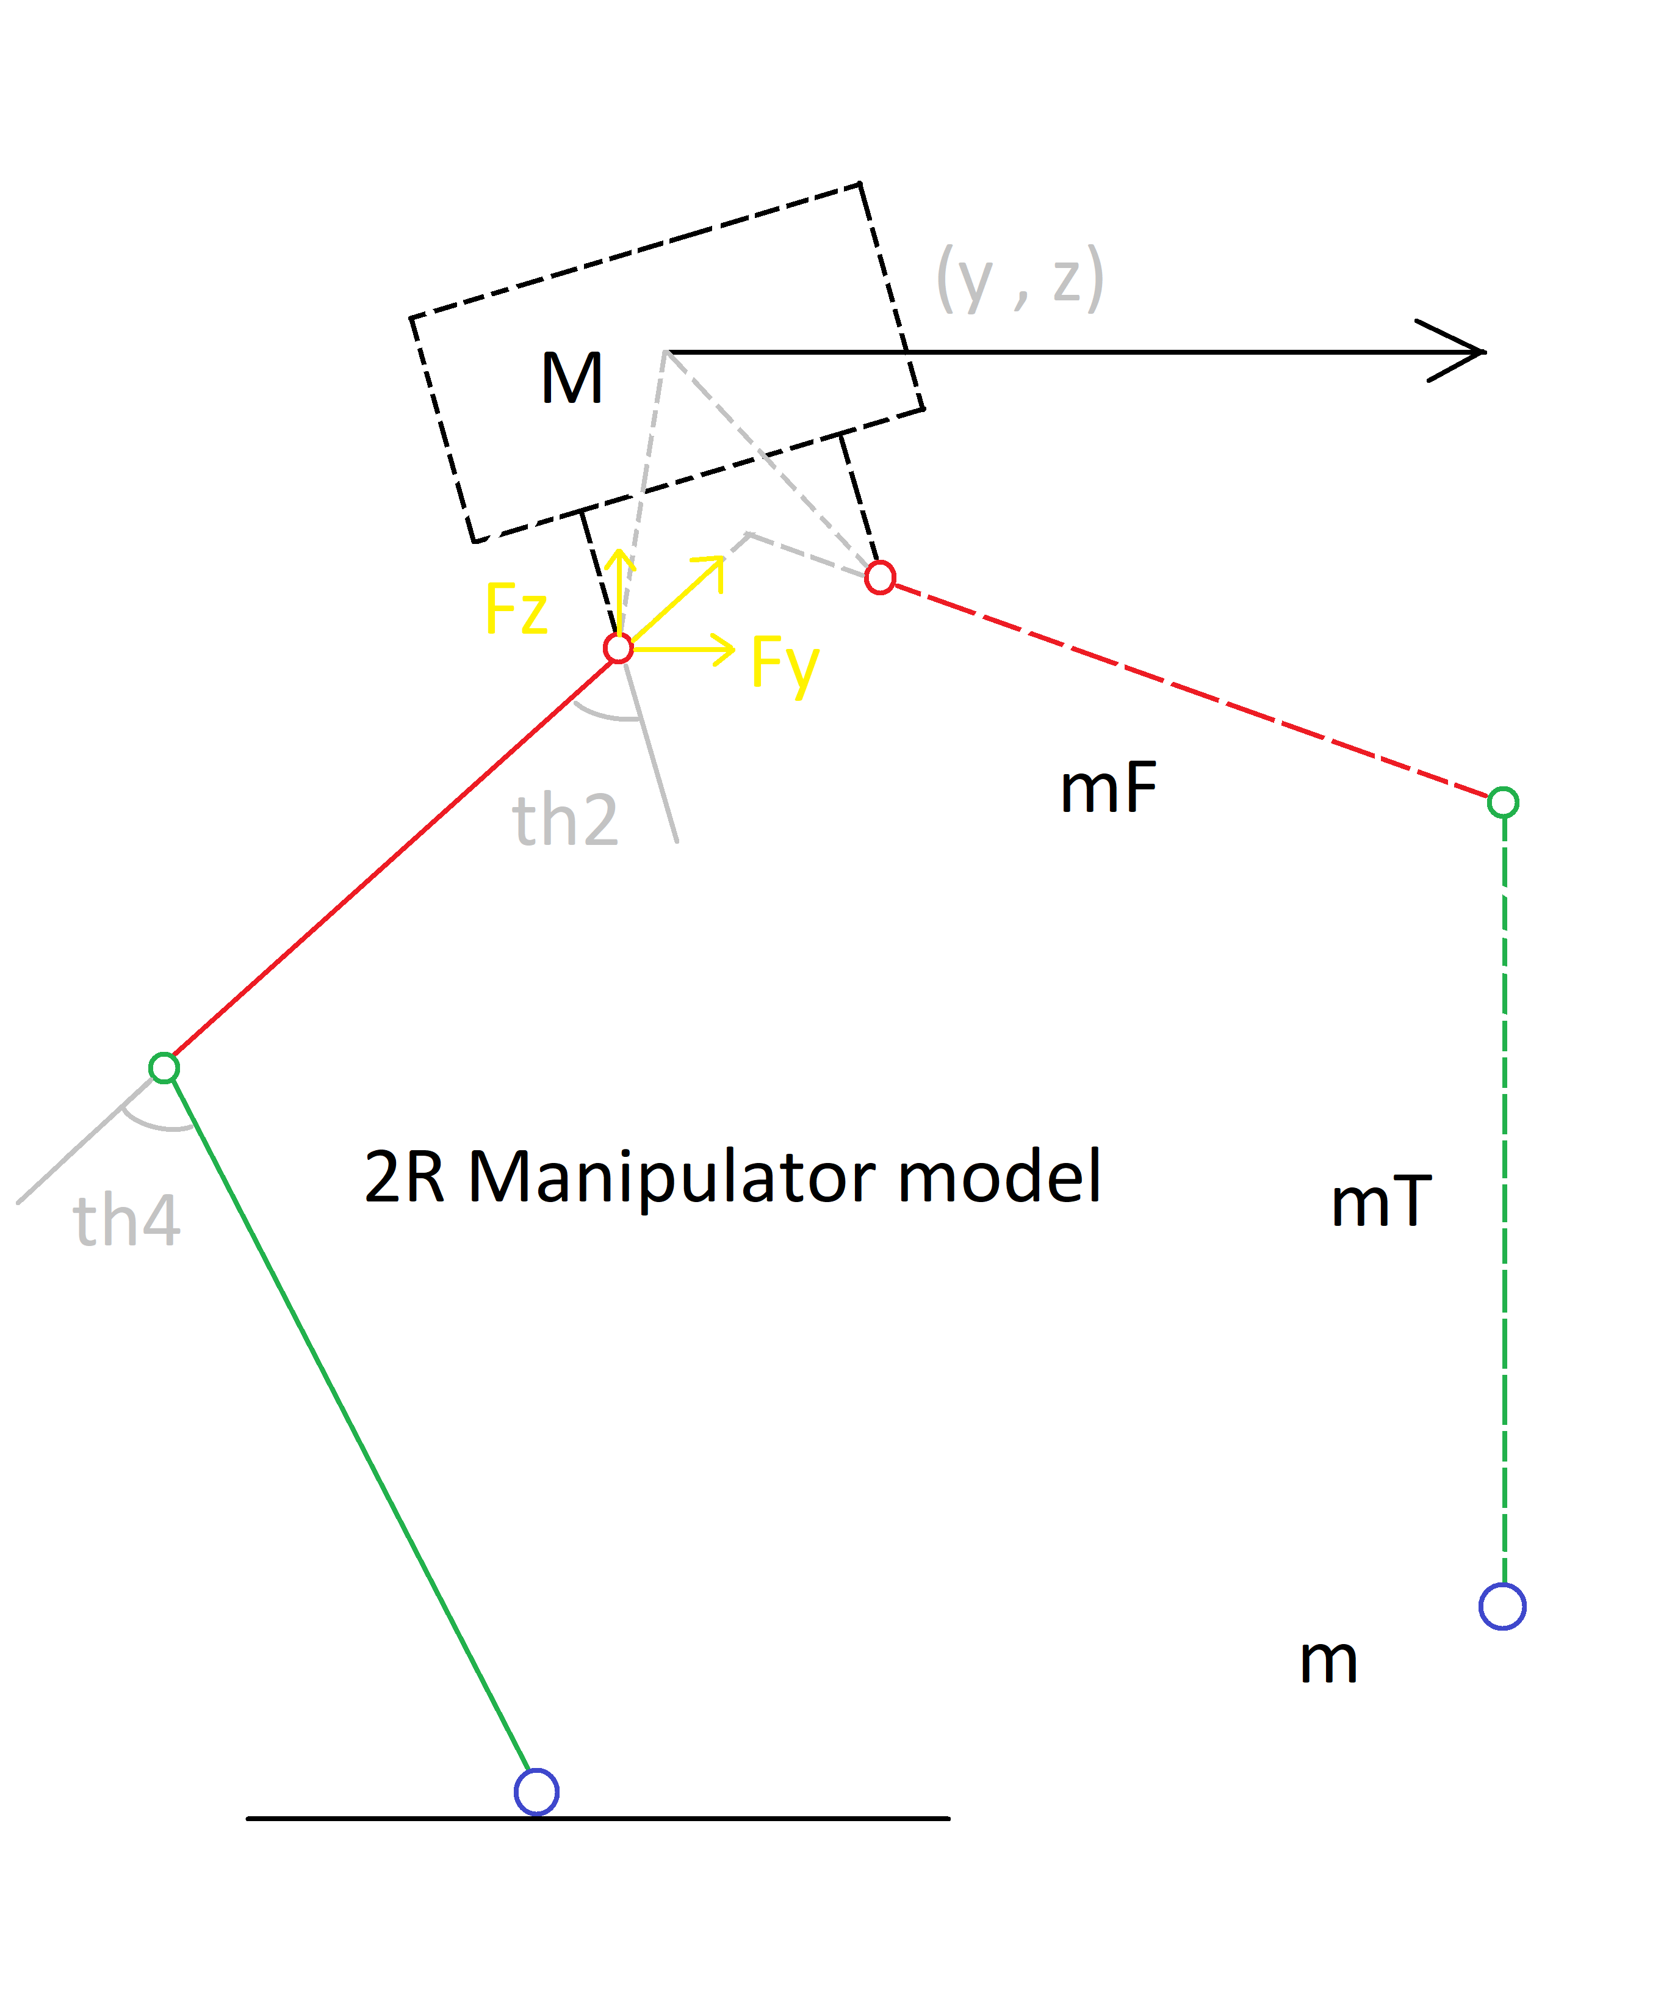
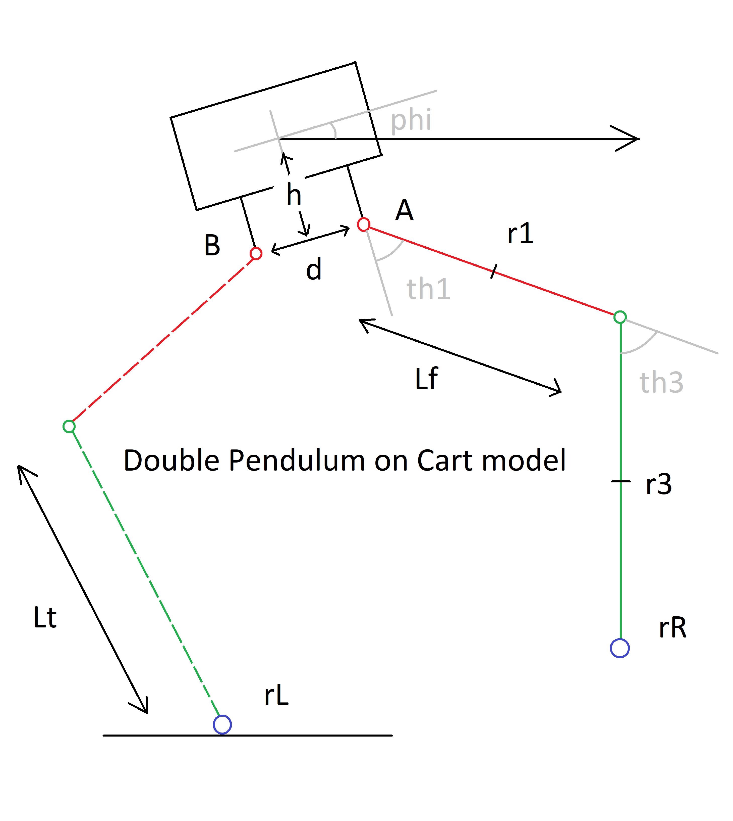

Slide 22
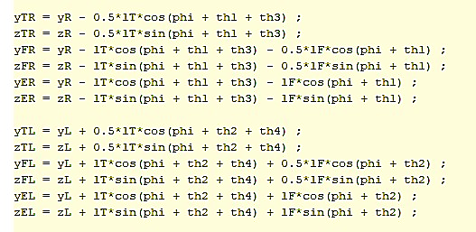

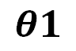

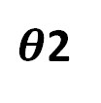
φ
FORWARD KINEMATICS
$$θ1$$
φ
rER
$θ$2
rEL
$θ$4
$θ$3
yL zL
yR zR

Slide 23
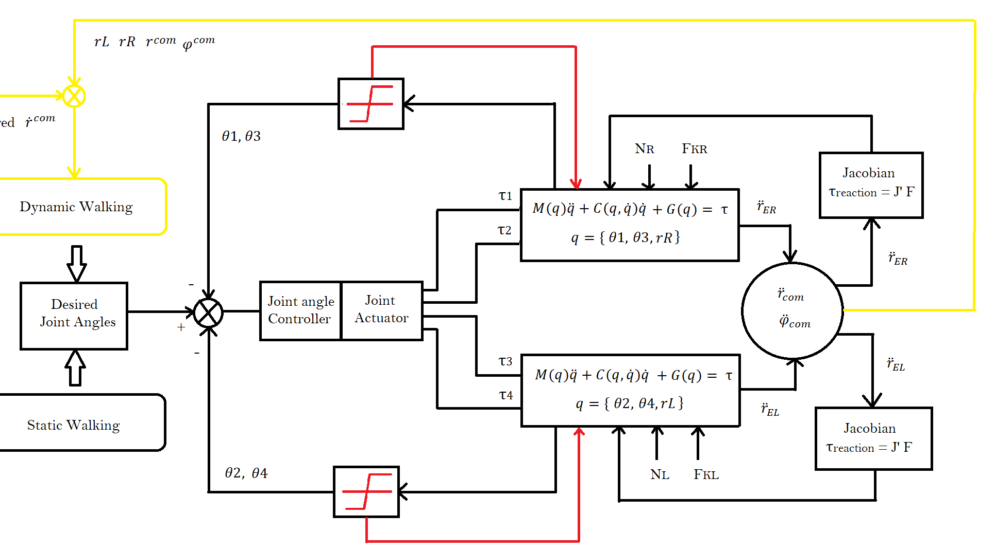

Slide 24
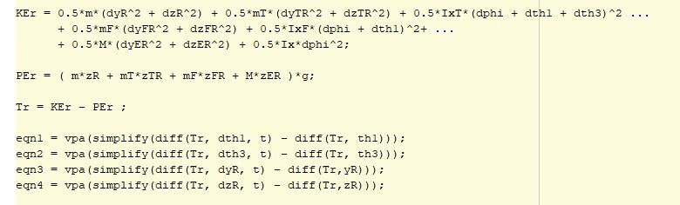
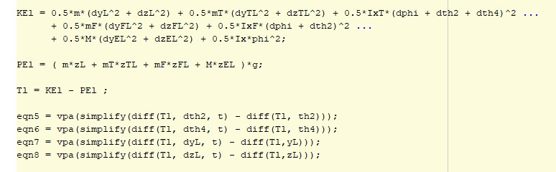
LAGRANGIAN MECHANICS

Slide 25
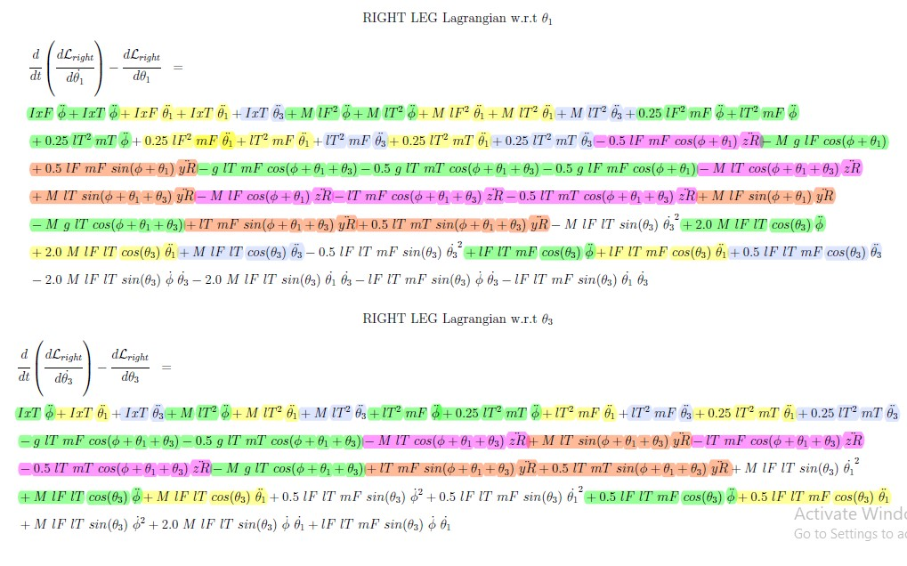

Slide 26
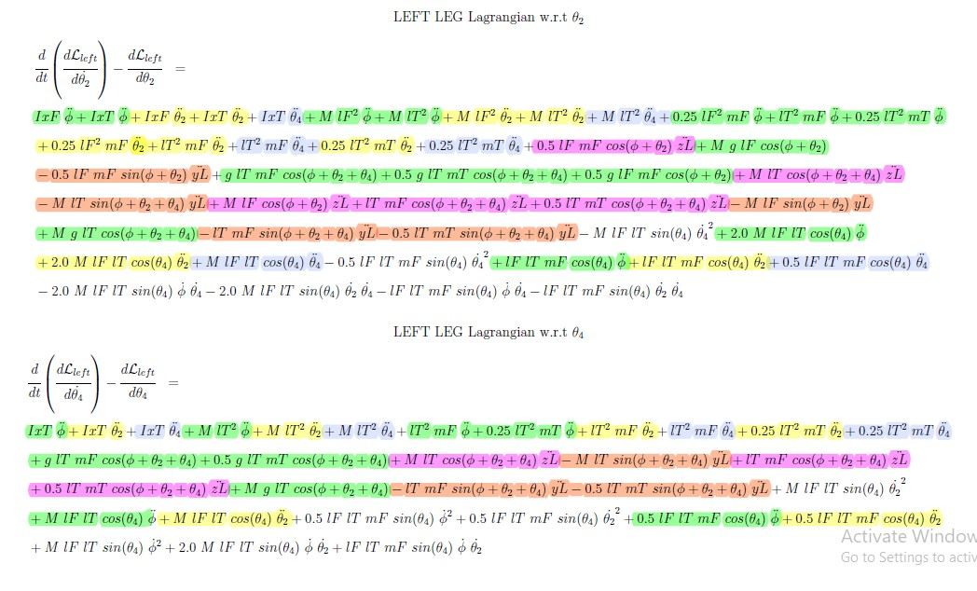

Slide 27
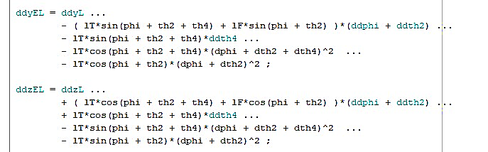
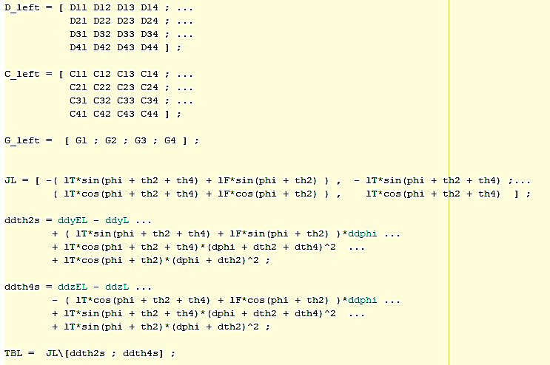
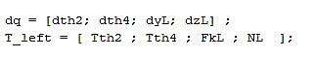
ACTION :
MASS MATRIX FORM :
REACTION :

Slide 28
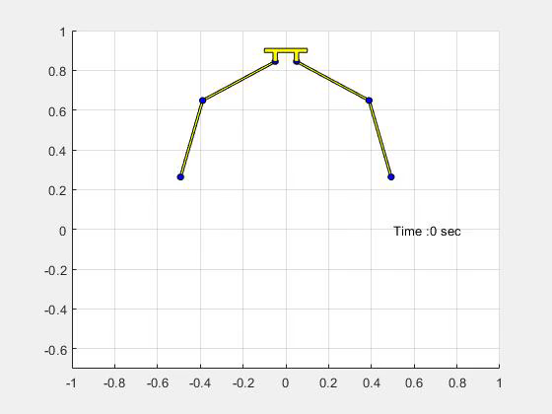
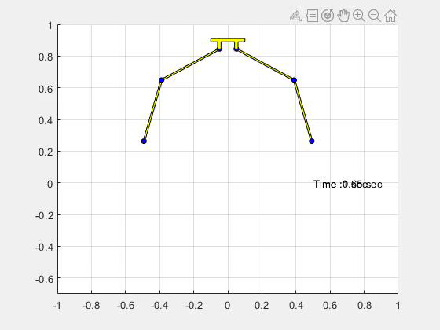
VIDEO
VIDEO
EFFECT OF JOIN LIMITS ON ROBOT DYNAMICS IN ZERO GRAVITY

Slide 29
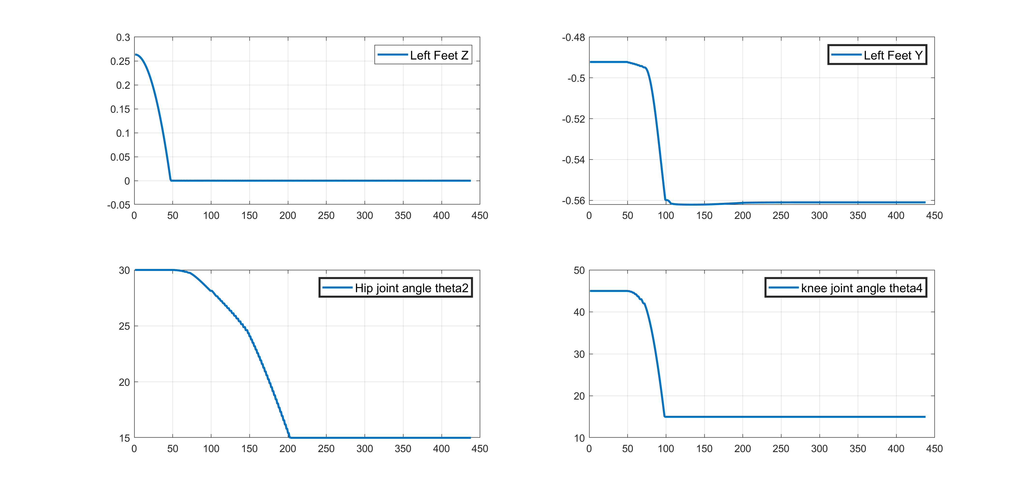
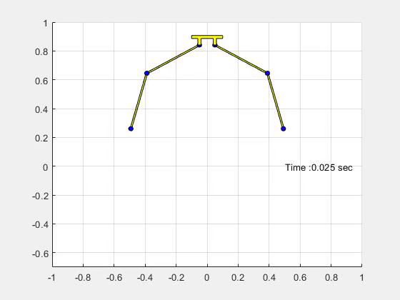
VIDEO
EFFECT OF NORMAL REACTION AND FRICTION ON FREE FALLING ROBOT DYNAMICS UNDER GRAVITY (ONLY LEFT LEG UNDER CONSIDERATION

Slide 30
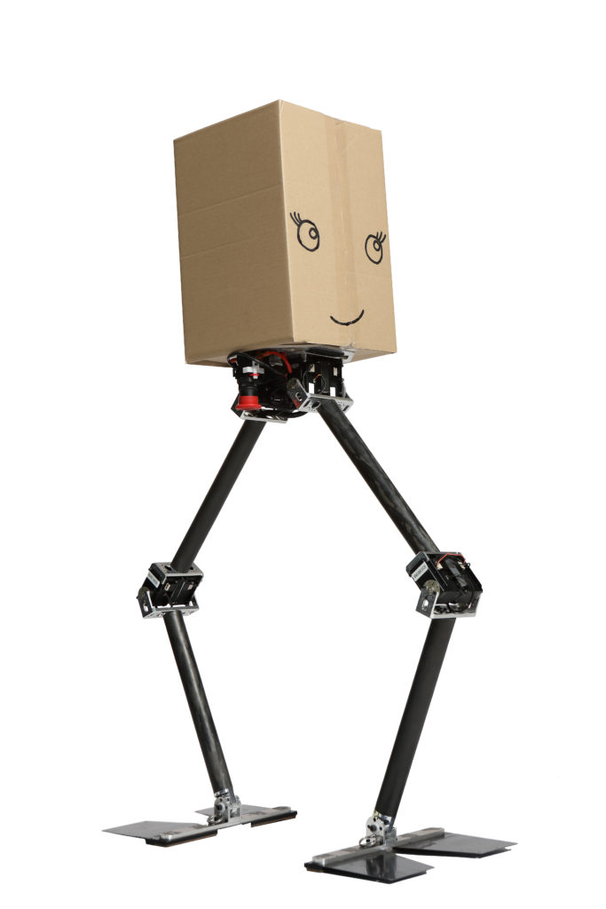
Reinforcement Learning for NABI Locomotion
Model:
Base - free joint
4 joints (2 at hip, 2 at knees) - hinge joints
Simulator:
Mujoco
Python interface:
OpenAI gym
Reinforcement Learning Algorithm:
ARS

Slide 31
Reinforcement Learning for NABI Locomotion
State Representation: R²¹
x,y,z co-ordinates of the base = 3
Euler angles of orientation of base = 3
Angles at hips and knees = 4
Transitional and angular velocities of base = 6
Angular velocities at hips and knees = 4
1 Constant bias term = 1
Actions: R⁴
Torques to be applied at hips and knees

Slide 32
Reinforcement Learning for NABI Locomotion
Reward function: R
Forward reward: 10 x forward velocity
Survival reward: 3
Out of line penalty: 10 x difference
Actuator cost
Policy: Deterministic Linear Policy.
M 𝜙(s) = a
RL Algorithm: ARS
Mania H, Guy A, Recht B. Simple random search provides a competitive approach to reinforcement learning.
Random search based algorithm
Derivative free
Highly parallelizable
Linear policy

Slide 33
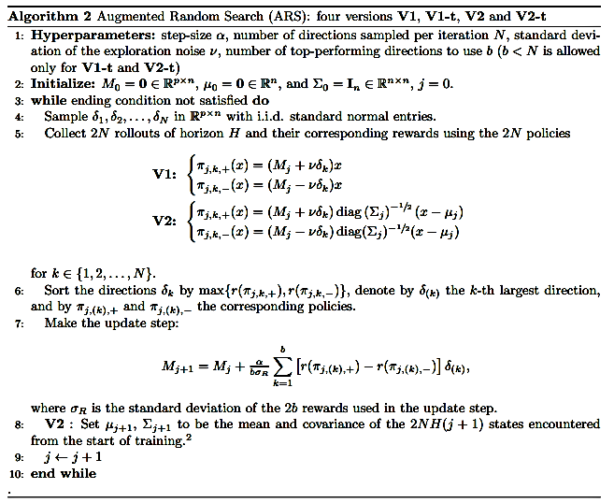
Reinforcement Learning for NABI Locomotion - ARS

Slide 34

Reinforcement Learning for NABI Locomotion
Hyperparameters of ARS:
N = 16
b = 8
lr = 0.02
noise = 0.03
Results:
Robot could complete walking on the wedge of 7 degrees.
Each trajectory is of 2000 timesteps.
Training took 10⁷ simulation timesteps.
~ 20 - 30 mins
Demo video
VIDEO

Slide 35


Future Work 1
Combine Control and Learning for sample efficiency
Learn the dynamics model using random action trajectories.
Consequently plan for action sequences according to the learned model.
Data Efficient Reinforcement Learning for Legged Robots. (2020)
Yang Y, et al.
In: Conference on Robot Learning.

Slide 36

Future work 2
Meta RL for varying slopes
Training from scratch for each slope is expensive/tedious.
Learn a generic policy which can walk on slopes.
Fine tune / adapt to new slopes quickly.
Use Meta Learning / Meta RL techniques for achieving this.

Slide 37
Contributions
Simulator:
Dynamics of Robot - MATLAB
ZMP
URDF - Modelling
Solidworks - 3D design
ZMP based trajectory - MATLAB
RL
Mujoco Model - MJCF xml file. (Reference was used)
Open AI environment - Python
Robot walking on the wedge - Python

Slide 38

Queries ??

